Slide 1

Department of Computer Science and Engineering
FAKE JOB RECRUITMENT DETECTION
Date: 28 May 2021
M.Priyanka : 17WH1A0505
M.Deepika : 17WH1A0511
K.Susritha : 17WH1A0554
Internal Guide : Ms. P. Kavitha Designation : Assistant Professor

Slide 2


Abstract
Why Should I Study this course?
Examples
BVRIT HYDERABAD College of Engineering for Women
Freshers are coming out from their education level to job experience level. In such process of finding their suitable jobs they are ending up in some fake jobs recruitment processes.
So, in order to find the fake recruitment, our project has come into existence. We are using machine learning approaches using classification techniques which are able to detect such fake recruitments.
Different classifiers are used for checking fraudulent posts in web and the results of those classifiers are compared for identifying the best employment scam detection model. It helps in finding the fake posts from enormous number of posts. We can use both the single classifier and ensemble classifier.

Slide 3
Data set
Why Should I Study this course?
Examples
BVRIT HYDERABAD College of Engineering for Women
Data set name : fake_job_postings.csv
Description : This file contains the dataset of job descriptions and their meta information. A small proportion of these descriptions are fake or scam which can be identified by the column "fraudulent".
Number of attributes : 18
Number of instances : 17880

Slide 4
Architecture
Why Should I Study this course?
Examples
Data Pre-processing
Formatting
Cleaning
Sampling
Dataset
Classifiers
Logistic Regression
KNN
SVM
Naive Bayes
Result
Test data

Slide 5

Technology Stack
Why Should I Study this course?
Examples
BVRIT HYDERABAD College of Engineering for Women
Machine learning using Python
Libraries Used :
Pandas
Numpy
Seaborne
Matplotlib
Sklearn
Tkinter

Slide 6
System Requirements
Why Should I Study this course?
Examples
BVRIT HYDERABAD College of Engineering for Women
Environment | Speciﬁcations
Hardware | 1GB RAM 80GB Hard Disk Intel Processor
Software | Windows OS Python GUI or Anaconda Navigators OS: Windows 10

Slide 7
Algorithm Used
Why Should I Study this course?
Examples
BVRIT HYDERABAD College of Engineering for Women
Naive Bayes Classifier
Decision Tree Classifier
K-nearest Neighbor Classifier
Random Tree Classifier
Logistic Regression
Support Vector Machine

Slide 8
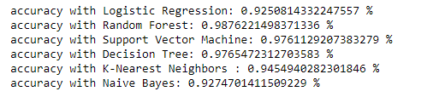
Accuracy
Why Should I Study this course?
Examples
BVRIT HYDERABAD College of Engineering for Women

Slide 9
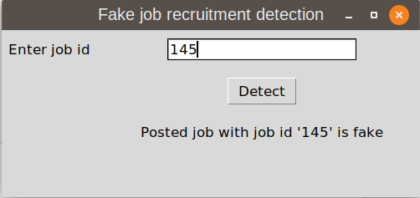
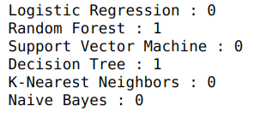
Test cases
Why Should I Study this course?
Examples
BVRIT HYDERABAD College of Engineering for Women

Slide 10
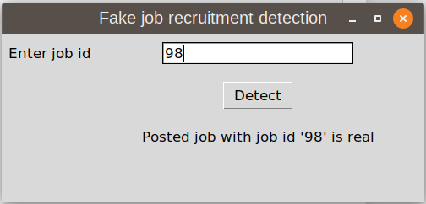
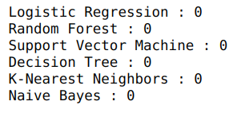
Test cases
Why Should I Study this course?
Examples
BVRIT HYDERABAD College of Engineering for Women

Slide 11
Timeline
Why Should I Study this course?
Examples
BVRIT HYDERABAD College of Engineering for Women
Review 0 | Requirements & Speciﬁcations
Review 1 | Data Collection
Review 2 | Data Pre-Processing Apply Algorithm
Review 3 | Evaluation

Slide 12
References
Why Should I Study this course?
Examples
BVRIT HYDERABAD College of Engineering for Women
Alghamdi, B., & Alharby, F. (2019). An Intelligent Model for Online Recruitment Fraud Detection. Journal of Information Security, 10(03), 155–176.
Bansal, S. (2020, February 29). [Real or Fake] Fake Job Posting Prediction. Kaggle.
Dutta, S., & Bandyopadhyay, S. K. (2020). Fake Job Recruitment Detection Using Machine Learning Approach. International Journal of Engineering Trends and Technology, 68(4), 48–53.
Hossin, M., & Sulaiman, M.N. (2015). A Review on Evaluation Metrics for Data Classification Evaluations. International Journal of Data Mining & Knowledge Management Process, 5(2), 01–11.
Sharma, H., & Kumar, S. (2016). A Survey on Decision Tree Algorithms of Classification in Data Mining. International Journal of Science and Research (IJSR), 5(4), 2094–2097

Slide 13
Thank you

